Slide 1

UNIX/HADOOP FUNDAMENTALS

Slide 2
CONTENTS
YARN Overview
InputFormats

Slide 3
Hadoop Yarn - Introduction
Apache Yarn – “Yet Another Resource Negotiator” is the resource management layer of Hadoop. The Yarn was introduced in Hadoop 2.x.
Yarn allows different data processing engines like graph processing, interactive processing, stream processing as well as batch processing to run and process data stored in HDFS (Hadoop Distributed File System).
Apart from resource management, Yarn also does job Scheduling.

Slide 4
Yarn extends the power of Hadoop to other evolving technologies, so they can take the advantages of HDFS (most reliable and popular storage system on the planet) and economic cluster.
Apache yarn is also a data operating system for Hadoop 2.x.
This architecture of Hadoop 2.x provides a general purpose data processing platform which is not just limited to the MapReduce.
It enables Hadoop to process other purpose-built data processing system other than MapReduce. It allows running several different frameworks on the same hardware where Hadoop is deployed.

Slide 5
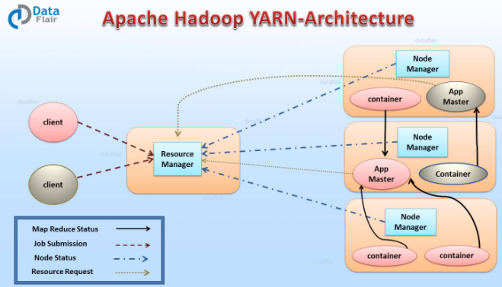
Hadoop Yarn Architecture

Slide 6
1.Resource Manager (RM)
It is the master daemon of Yarn.
RM manages the global assignments of resources (CPU and memory) among all the applications.
It arbitrates system resources between competing applications.
Resource Manager has two Main components:
Scheduler
Application manager

Slide 7
a) Scheduler
The scheduler is responsible for allocating the resources to the running application.
The scheduler is pure scheduler it means that it performs no monitoring no tracking for the application and even doesn’t guarantees about restarting failed tasks either due to application failure or hardware failures.
b) Application Manager
It manages running Application Masters in the cluster, i.e., it is responsible for starting application masters and for monitoring and restarting them on different nodes in case of failures.

Slide 8
2. Node Manager (NM)
It is the slave daemon of Yarn. NM is responsible for containers monitoring their resource usage and reporting the same to the ResourceManager.
Manage the user process on that machine. Yarn NodeManager also tracks the health of the node on which it is running.
The design also allows plugging long-running auxiliary services to the NM; these are application-specific services, specified as part of the configurations and loaded by the NM during startup.
A shuffle is a typical auxiliary service by the NMs for MapReduce applications on YARN

Slide 9
3. Application Master (AM)
One application master runs per application.
It negotiates resources from the resource manager and works with the node manager.
It Manages the application life cycle.
The AM acquires containers from the RM’s Scheduler before contacting the corresponding NMs to start the application’s individual tasks.

Slide 10
Resource Manager Restart
Resource Manager is the central authority that manages resources and schedules applications running on YARN.
Hence, it is potentially an SPOF in an Apache YARN cluster.
There are two types of restart for Resource Manager:

Slide 11
Non-work-preserving RM restart
This restart enhances RM to persist application/attempt state in a pluggable state-store.
Resource Manager will reload the same info from state-store on the restart and re-kick the previously running apps.
Users does not need to re-submit the applications. Node manager and clients during down time of RM will keep polling RM until RM comes up, when RM comes up, it will send a re-sync command to all the NM and AM it was talking to via heartbeats.
The NMs will kill all its manager’s containers and re-register with RM.

Slide 12
Work-preserving RM restart
This focuses on reconstructing the running state of RM by combining the container status from Node Managers and container requests from Application Masters on restart.
The key difference from Non-work-preserving RM restart is that already running apps will not be stopped after master restarts, so applications will not lose its processed data because of RM/master outage.
RM recovers its running state by taking advantage of container status which is sent from all the node managers.
NM will not kill the containers when it re-syncs with the restarted RM. It continues managing the containers and sends the container status across to RM when it re-registers.

Slide 13
Yarn Resource Manager High Availability
The ResourceManager (master) is responsible for handling the resources in a cluster, and scheduling multiple applications (e.g., spark apps or MapReduce).
The High Availability feature adds redundancy in the form of an Active/Standby ResourceManager pair to remove this otherwise single point of failure.
ResourceManager HA is realized through an Active/Standby architecture – at any point in time, one in the masters is Active, and other Resource Managers are in Standby mode, they are waiting to take over when anything happens to the Active.
The trigger to transition-to-active comes from either the admin (through CLI) or through the integrated failover-controller when automatic failover is enabled.

Slide 14
1. Manual transitions and failover
When automatic failover is not configured, admins have to manually transit one of the Resource managers to the active state.
Failover from active master to the other, they are expected to transmit the active master to standby and transmit a Standby-RM to Active.
Hence, this activity can be done using the yarn.

Slide 15
2. Automatic failover
In this case, there is no need for any manual intervention.
The master has an option to embed the Zookeeper (a coordination engine) based ActiveStandbyElector to decide which Resource Manager should be the Active.
When the active fails, another Resource Manager is automatically selected to be active.
Note that, there is no need to run a separate zookeeper daemon because ActiveStandbyElector embedded in Resource Managers acts as a failure detector and a leader elector instead of a separate ZKFC daemon.

Slide 16
Yarn Web Application Proxy
It is also the part of Yarn.
By default, it runs as a part of RM but we can configure and run in a standalone mode. Hence, the reason of the proxy is to reduce the possibility of the web-based attack through Yarn.
In Yarn, the AM has a responsibility to provide a web UI and send that link to RM.
RM runs as trusted user, and provide visiting that web address will treat it and link it provides to them as trusted when in reality the AM is running as non-trusted user, application Proxy mitigate this risk by warning the user that they are connecting to an untrusted site.

Slide 17
Yarn Docker Container Executor
Docker combines an easy to use interface to Linux container with easy to construct files for those containers.
Docker generates light weighted virtual machine. The Docker Container Executor allows the Yarn NodeManager to launch yarn container to Docker container.
Hence, these containers provide a custom software environment in which user’s code run, isolated from a software environment of NodeManager.
Hence, Docker for YARN provides both consistency (all YARN containers will have similar environment) and isolation (no interference with other components installed on the same machine).

Slide 18
Yarn Timeline Server
The storage and retrieval of application’s current and historic information in a generic fashion is addressed by the timeline service in Yarn.
1. Persisting application specific information
The collection or retrieval of information completely specific to a specific application or framework. For Example, Hadoop MapReduce framework consists the pieces of information about the map task, reduce task and counters.
Application developer publishes their specific information to the Timeline Server via TimeLineClient in the application Master or application container.

Slide 19
2. Persisting general information about completed applications
Generic information includes application-level data such as:
Queue-name
User information and the like set in the ApplicationSubmissionContext
Info about each application-attempt
A list of application-attempts that ran for an application
The list of containers run under each application-attempt
Information about each container

Slide 20
Yarn Timeline service version 2
It is the major iteration of the timeline server. Thus, V2 addresses two major challenges:
The previous version does not well scale up beyond small cluster.
And single instance available for the write and read.
Hence, In the v2 there is a different collector for write and read, it uses distributed collector, one collector for each Yarn application.

Slide 21
Hadoop Yarn Resource Manager - Introduction
The Resource Manager is the core component of YARN – Yet Another Resource Negotiator.
In analogy, it occupies the place of JobTracker of MRV1. Hadoop YARN is designed to provide a generic and flexible framework to administer the computing resources in the Hadoop cluster.
In this direction, the YARN Resource Manager Service (RM) is the central controlling authority for resource management and makes allocation decisions ResourceManager has two main components: Scheduler and ApplicationsManager.

Slide 22
The Scheduler API is specifically designed to negotiate resources and not schedule tasks. The scheduler does not perform monitoring or tracking of status for the Applications.
The Scheduler performs its scheduling function based the resource requirements of the applications; it does so base on the abstract notion of a resource Container which incorporates elements such as memory, CPU, disk, network etc.
Hadoop Yarn Resource Manager does not guarantee about restarting failed tasks either due to application failure or hardware failures. Applications can request resources at different layers of the cluster topology such as nodes, racks etc.

Slide 23
Hence, the scheduler determines how much and where to allocate based on resource availability and the configured sharing policy.
The Scheduler has a pluggable policy plug-in, which is responsible for partitioning the cluster resources among the various queues, applications etc.
The current Map-Reduce schedulers such as the CapacityScheduler and the FairScheduler would be some examples of the plug-in ApplicationsManager is responsible for maintaining a collection of submitted applications.

Slide 24
It accepts a job from the client and negotiates for a container to execute the application specific ApplicationMaster and it provide the service for restarting the ApplicationMaster in the case of failure.
It also keeps a cache of completed applications so as to serve users’ requests via web UI or command line long after the applications in question finished.
Though the above two are the core component, for its complete functionality the Resource Manager depend on various other components.

Slide 25
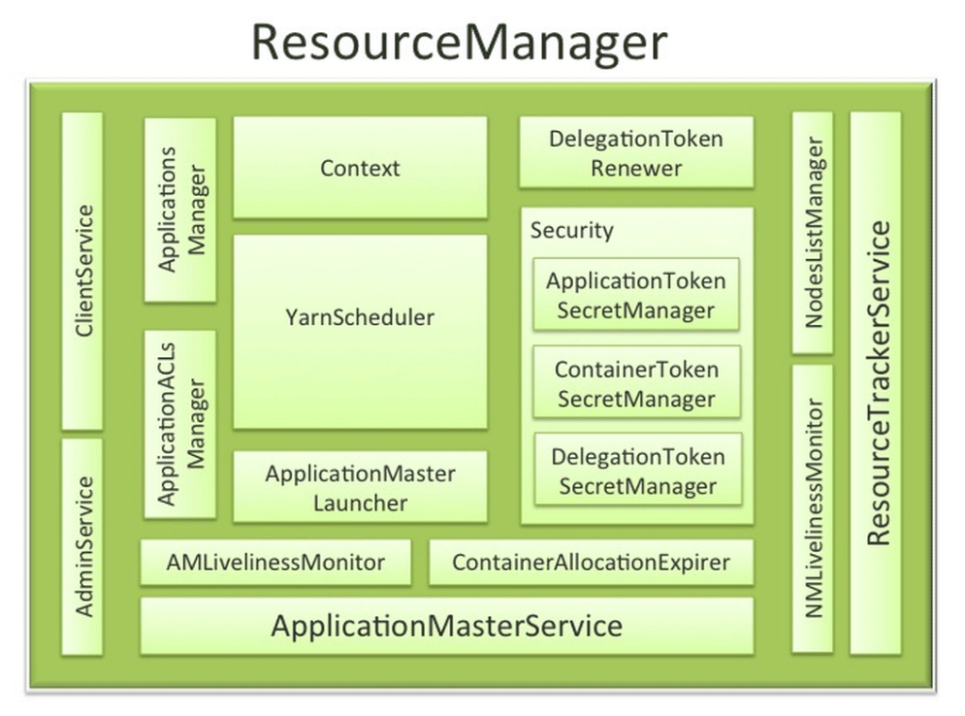
Hadoop Yarn Resource Manager

Slide 26
Hadoop Yarn Resource Manager Components
RM works together with the per-node NodeManagers (NMs) and the per-application ApplicationMasters (AMs).The ResourceManager has the following components:
1. Components interfacing RM to the client
a) ClientService
The client interface to the Resource Manager.
This component handles all the RPC interfaces to the RM from the clients including operations like application submission, application termination, obtaining queue information, cluster statistics etc.

Slide 27
b) AdminService
To make sure that admin requests don’t get starved due to the normal users’ requests and to give the operators’ commands the higher priority, all the admin operations like refreshing node-list, the queues’ configuration etc. are served via this separate interface.
2. Components connecting RM to the nodes
a) ResourceTrackerService
This is the component that obtains heartbeats from nodes in the cluster and forwards them to YarnScheduler.
Responds to RPCs from all the nodes, registers new nodes, rejecting requests from any invalid/decommissioned nodes, It works closely with NMLivelinessMonitor and NodesListManager.

Slide 28
b) NMLivelinessMonitor
To keep track of live nodes and dead nodes. This component keeps track of each node’s its last heartbeat time.
Any node that doesn’t send a heartbeat within a configured interval of time, by default 10 minutes, is deemed dead and is expired by the RM.
All the containers currently running on an expired node are marked as dead and no new containers are scheduling on such node.

Slide 29
c) NodesListManager
Manages valid and excluded nodes.
Responsible for reading the host configuration files and seeding the initial list of nodes based on those files.
Keeps track of nodes that are decommissioned as time progresses.

Slide 30
3. Components interacting with the per-application AMs
a) ApplicationMasterService
Services the RPCs from all the AMs like registration of new AMs, termination/unregister-requests from any finishing AMs, obtaining container-allocation & deallocation requests from all running AMs and forward them over to the YarnScheduler.
Thus ApplicationMasterService and AMLivelinessMonitor work together to maintain the fault tolerance of Application Masters.

Slide 31
b) AMLivelinessMonitor
Maintains the list of live AMs and dead/non-responding AMs, Its responsibility is to keep track of live AMs, it usually tracks the AMs dead or alive with the help of heartbeats, and register and de-register the AMs from the Resource manager.
Hence, all the containers currently running/allocated to an AM that gets expired are marked as dead.

Slide 32
4. The core of the ResourceManager – the scheduler and related components
a) ApplicationsManager
Responsible for maintaining a collection of submitted applications.
Also, keeps a cache of completed applications so as to serve users’ requests via web UI or command line long after the applications in question finished.

Slide 33
b) ApplicationACLsManager
RM needs to gate the user facing APIs like the client and admin requests to be accessible only to authorized users.
This component maintains the ACLs lists per application and enforces them whenever a request like killing an application, viewing an application status is received.
c) ApplicationMasterLauncher
Maintains a thread-pool to launch AMs of newly submitted applications as well as applications whose previous AM attempts exited due to some reason.
Also responsible for cleaning up the AM when an application has finished normally or forcefully terminated.

Slide 34
d) YarnScheduler
Yarn Scheduler is responsible for allocating resources to the various running applications subject to constraints of capacities, queues etc.
It also performs its scheduling function based on the resource requirements of the applications.
For example, memory, CPU, disk, network etc. Currently, only memory is supported and support for CPU is close to completion.

Slide 35
e) ContainerAllocationExpirer
This component is in charge of ensuring that all allocated containers are used by AMs and subsequently launched on the correspond NMs.
AMs run as untrusted user code and can potentially hold on to allocations without using them, and as such can cause cluster under-utilization. To address this, ContainerAllocationExpirer maintains the list of allocated containers that are still not used on the corresponding NMs.
For any container, if the corresponding NM doesn’t report to the RM that the container has started running within a configured interval of time, by default 10 minutes, then the container is deemed as dead and is expired by the RM.

Slide 36
5. TokenSecretManagers (for security)
Hadoop Yarn Resource Manager has a collection of SecretManagers for the charge/responsibility of managing tokens, secret keys for authenticate/authorize requests on various RPC interfaces. A brief summary follows:
a) ApplicationTokenSecretManager
RM uses the per-application tokens called ApplicationTokens to avoid arbitrary processes from sending RM scheduling requests.
This component saves each token locally in memory till application finishes.
Then uses it to authenticate any request coming from a valid AM process.

Slide 37
b) ContainerTokenSecretManager
RM issues special tokens called Container Tokens to ApplicationMaster(AM) for a container on the specific node.
Hence, these tokens are used by AM to create a connection with NodeManager having the container in which job runs.
c) RMDelegationTokenSecretManager
A ResourceManager specific delegation-token secret-manager.
It is responsible for generating delegation tokens to clients which can also be passed on to unauthenticated processes that wish to be able to talk to RM.

Slide 38
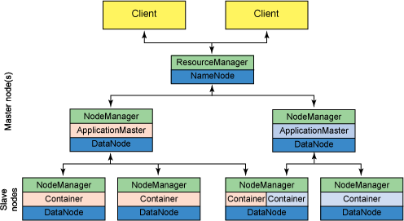
6. DelegationTokenRenewer

Slide 39
In secure mode, RM is Kerberos authenticated. Hence provides the service of renewing file-system tokens on behalf of the applications.
This component renews tokens of submitted applications as long as the application runs and till the tokens can no longer be renewed.
The responsibility and functionalities of the NameNode and DataNode remained the same as in MRV1.

Slide 40
Hadoop Yarn Node Manager - Introduction
Conceptually, the NodeManager is more of a generic and efficient version of TaskTracker which is more flexible than TaskTracker.
In contrast to fixed number of slots for map and reduce tasks in MRV1, the NodeManager of MRV2 has a number of dynamically created resource containers. There is no hard code split available into Map and Reduce slots as in MRV1.
The container refers to a collection of resources such as memory, CPU, disk and network IO. The number of containers on a node is the product of configuration parameter and the total amount of node resources. Node manager is the slave daemon of Yarn.

Slide 41
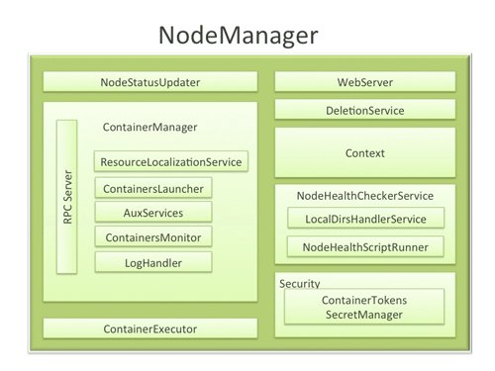
Hadoop Yarn Node Manager

Slide 42
The Hadoop Yarn Node Manager is the per-machine/per-node framework agent who is responsible for containers, monitoring their resource usage and reporting the same to the ResourceManager.
Overseeing container’s lifecycle management, NodeManager also tracks the health of the node on which it is running, controls auxiliary services which different YARN applications may exploit at any point in time.
NodeManager can execute any computations that make sense to ApplicationMaster just by creating the container for each task.The above architecture diagram gives a detailed view of the NodeManager components.
The above architecture diagram gives a detailed view of the NodeManager components.

Slide 43
Yarn Node Manager Components
This section of Hadoop Yarn node manager tutorial will provide you a detailed description of yarn node manager components-
1. NodeStatusUpdater
On startup, this component registers with the ResourceManager(RM) and sends information about the resources available to every node. Subsequent NM-RM communication exchange updates on container statuses of every node like containers running on the node completed containers, etc.
In addition, the RM may signal the NodeStatusUpdater to potentially kill already running containers.

Slide 44
2. Container Manager
Being the core component of the NodeManager, shoulder the responsibilities of managing the containers running on each node with its sub-components, each of which performs a subset of the functionality that is needed to manage containers running on the node.
RPC server
ContainerManager, that accepts requests from Application Masters (AMs) to start new containers, or to stop running ones.
It works in association with ContainerTokenSecretManager to authorize all requests.

Slide 45
All the operations performed on containers running on this node are written to an audit log which can be post-processed by security tools.
ResourceLocalizationService
Responsible for securely downloading and organizing various file resources needed by containers.
It tries its best to distribute the files across all the available disks.
It also enforces access control restrictions of the downloaded files and puts appropriate usage limits on them.

Slide 46
ContainersLauncher
Maintains a pool of threads to prepare and launch containers as quickly as possible.
Also, cleans up the containers’ processes when such a request is sent by the RM or the ApplicationMasters (AMs).
AuxServices
The NM provides a framework for extending its functionality by configuring auxiliary services.

Slide 47
This allows per-node custom services that specific frameworks may require, and still sandbox them from the rest of the NM.
These services have to be configured before NM starts.
Auxiliary services are notified when an application’s first container starts on the node, and when the application is considered to be complete.

Slide 48
ContainersMonitor
This component starts observing its resource utilization while the container is running.
To enforce isolation and fair sharing of resources like memory, each container is allocated some amount of such a resource by the RM.
The ContainersMonitor monitors each container’s usage continuously and if a container exceeds its allocation, it signals the container to be killed.
This is done to prevent any runaway container from adversely affecting other well-behaved containers running on the same node.

Slide 49
LogHandler- A pluggable component with the option of either keeping the containers’ logs on the local disks or zipping them together and uploading them onto a file-system.
3. Container Executor
Interacts with the underlying operating system to securely place files and directories needed by containers and subsequently to launch and clean up processes corresponding to containers in a secure manner.

Slide 50
4. NodeHealthChecker Service
The functionality of checking the health of the node by running a configured script regularly is the due responsibility of NodeHealthCheckerService.
It also monitors the health of the disks specifically by creating temporary files on the disks every so often.
Any changes in the health of the system are notified to NodeStatusUpdater which in turn passes on the information to the RM.

Slide 51
5. Security
ContainerTokenSecretManager: Examines incoming requests for containers to ensure that all the incoming requests are indeed properly authorized by the ResourceManager
6. WebServer
In the case of MapReduce applications, the Map and Reduce tasks are executed inside the container. However, in between the Map and Reduce tasks (i.e, outside the containers) there is the ‘Shuffle and Sort’ phase.

Slide 52
The actions within this phase must be additionally specified to YARN as a NodeManager auxiliary service. Below is an illustration.
To summarize briefly, the key functionality of the NodeManager is to facilitate container launch on request from AM. Receiving the container launch request, the NM verifies this request, authorizes the user before resources assignment.

Slide 53
Hadoop InputFormat
Hadoop InputFormat describes the input-specification for execution of the Map-Reduce job.
InputFormat describes how to split up and read input files. In MapReduce job execution, InputFormat is the first step. It is also responsible for creating the input splits and dividing them into records.
Input files store the data for MapReduce job. Input files reside in HDFS. Although these files format is arbitrary, we can also use line-based log files and binary format.

Slide 54
Hence, In MapReduce, InputFormat class is one of the fundamental classes which provides below functionality:
InputFormat selects the files or other objects for input.
It also defines the Data splits. It defines both the size of individual Map tasks and its potential execution server.
Hadoop InputFormat defines the RecordReader. It is also responsible for reading actual records from the input files.

Slide 55
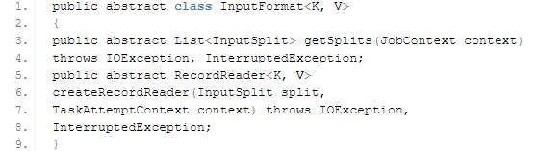
How we get the data from Mapper?
Methods to get the data from mapper are: getsplits() and createRecordReader() which are as follows:

Slide 56
Types of InputFormat in MapReduce
There are different types of MapReduce InputFormat in Hadoop which are used for different purpose. Let’s discuss the Hadoop InputFormat types below:
1. FileInputFormat
It is the base class for all file-based InputFormats.
FileInputFormat also specifies input directory which has data files location.

Slide 57
When we start a MapReduce job execution, FileInputFormat provides a path containing files to read. This InpuFormat will read all files.
Then it divides these files into one or more InputSplits.
2. TextInputFormat
It is the default InputFormat.
This InputFormat treats each line of each input file as a separate record. It performs no parsing.

Slide 58
TextInputFormat is useful for unformatted data or line-based records like log files. Hence,
Key – It is the byte offset of the beginning of the line within the file (not whole file one split). So it will be unique if combined with the file name.
Value – It is the contents of the line. It excludes line terminators.
3. KeyValueTextInputFormat
It is similar to TextInputFormat.
This InputFormat also treats each line of input as a separate record.

Slide 59
While the difference is that TextInputFormat treats entire line as the value, but the KeyValueTextInputFormat breaks the line itself into key and value by a tab character (‘/t’). Hence,
Key – Everything up to the tab character.
Value – It is the remaining part of the line after tab character.

Slide 60
4. SequenceFileInputFormat
It is an InputFormat which reads sequence files.
Sequence files are binary files. These files also store sequences of binary key-value pairs. These are block-compressed and provide direct serialization and deserialization of several arbitrary data.
Hence, Key & Value both are user-defined.

Slide 61
5. SequenceFileAsTextInputFormat
It is the variant of SequenceFileInputFormat.
This format converts the sequence file key values to Text objects.
So, it performs conversion by calling ‘tostring()’ on the keys and values.
Hence, SequenceFileAsTextInputFormat makes sequence files suitable input for streaming.
6. SequenceFileAsBinaryInputFormat
By using SequenceFileInputFormat we can extract the sequence file’s keys and values as an opaque binary object.

Slide 62
7. NlineInputFormat
It is another form of TextInputFormat where the keys are byte offset of the line and values are contents of the line.
So, each mapper receives a variable number of lines of input with TextInputFormat and KeyValueTextInputFormat.
The number depends on the size of the split. Also, depends on the length of the lines.

Slide 63
So, if want our mapper to receive a fixed number of lines of input, then we use NLineInputFormat.
N- It is the number of lines of input that each mapper receives.
By default (N=1), each mapper receives exactly one line of input.
Suppose N=2, then each split contains two lines. So, one mapper receives the first two Key-Value pairs. Another mapper receives the second two key-value pairs.

Slide 64
8. DBInputFormat
This InputFormat reads data from a relational database, using JDBC.
It also loads small datasets, perhaps for joining with large datasets from HDFS using MultipleInputs. Hence,
Key – LongWritables
Value – DBWritables.

